Slide 1

Enershare

Slide 2
Sharing energy
Shouldn’t cost energy

Slide 3



Production Consumption

Slide 5

Surplus
Consumer

Slide 6






Powergrid
Prosumer
Consumer
Humans

Slide 7
No effort
Set it and forget it
Autonomy
See impact
Prosumer

Slide 8
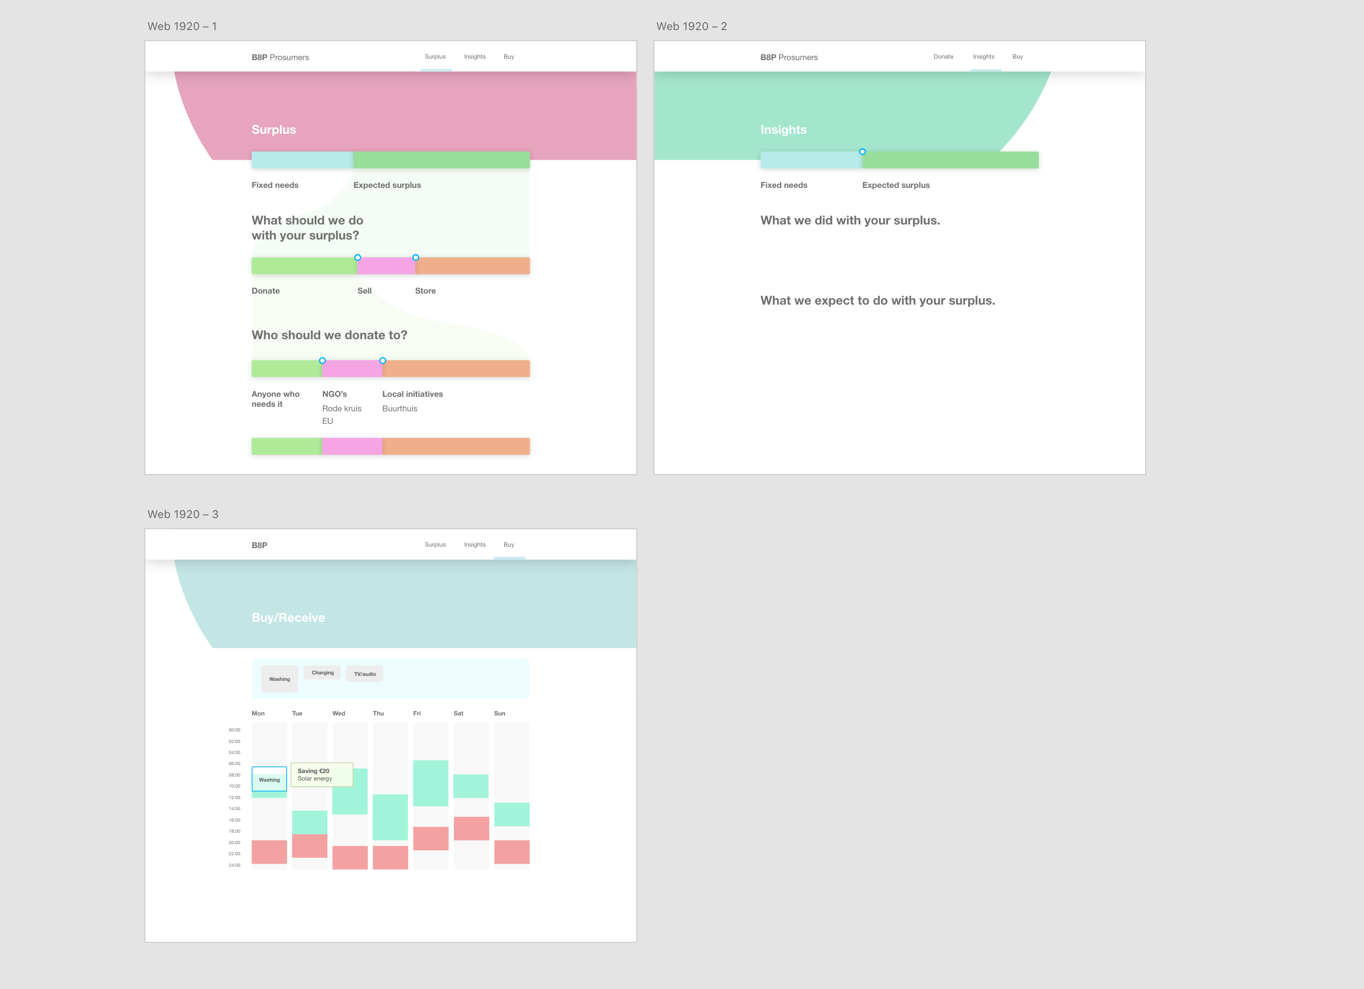

Slide 9
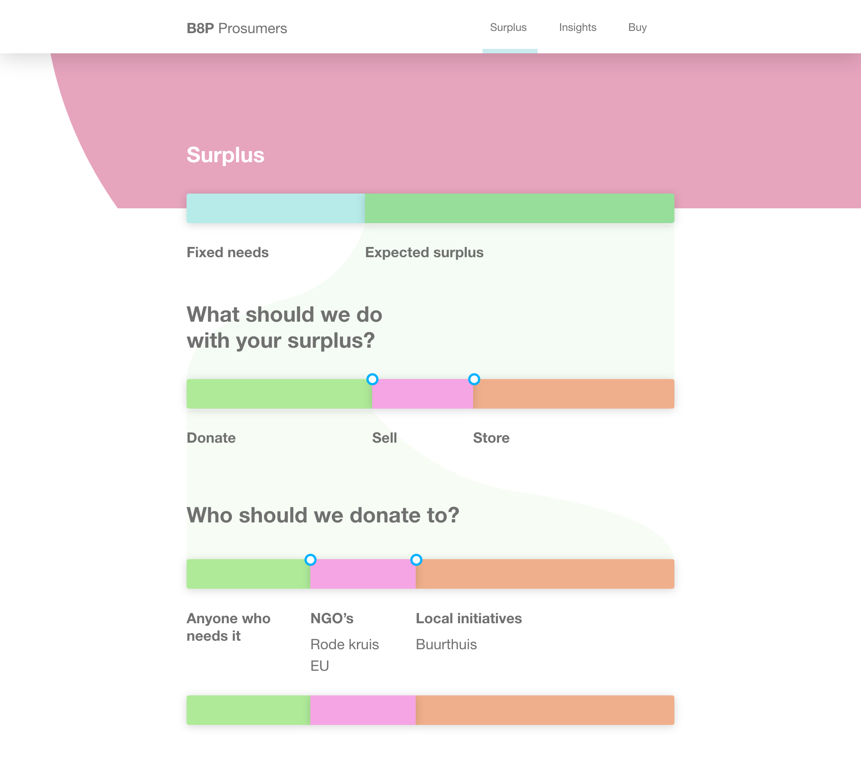

Slide 10
Enershare

Slide 11
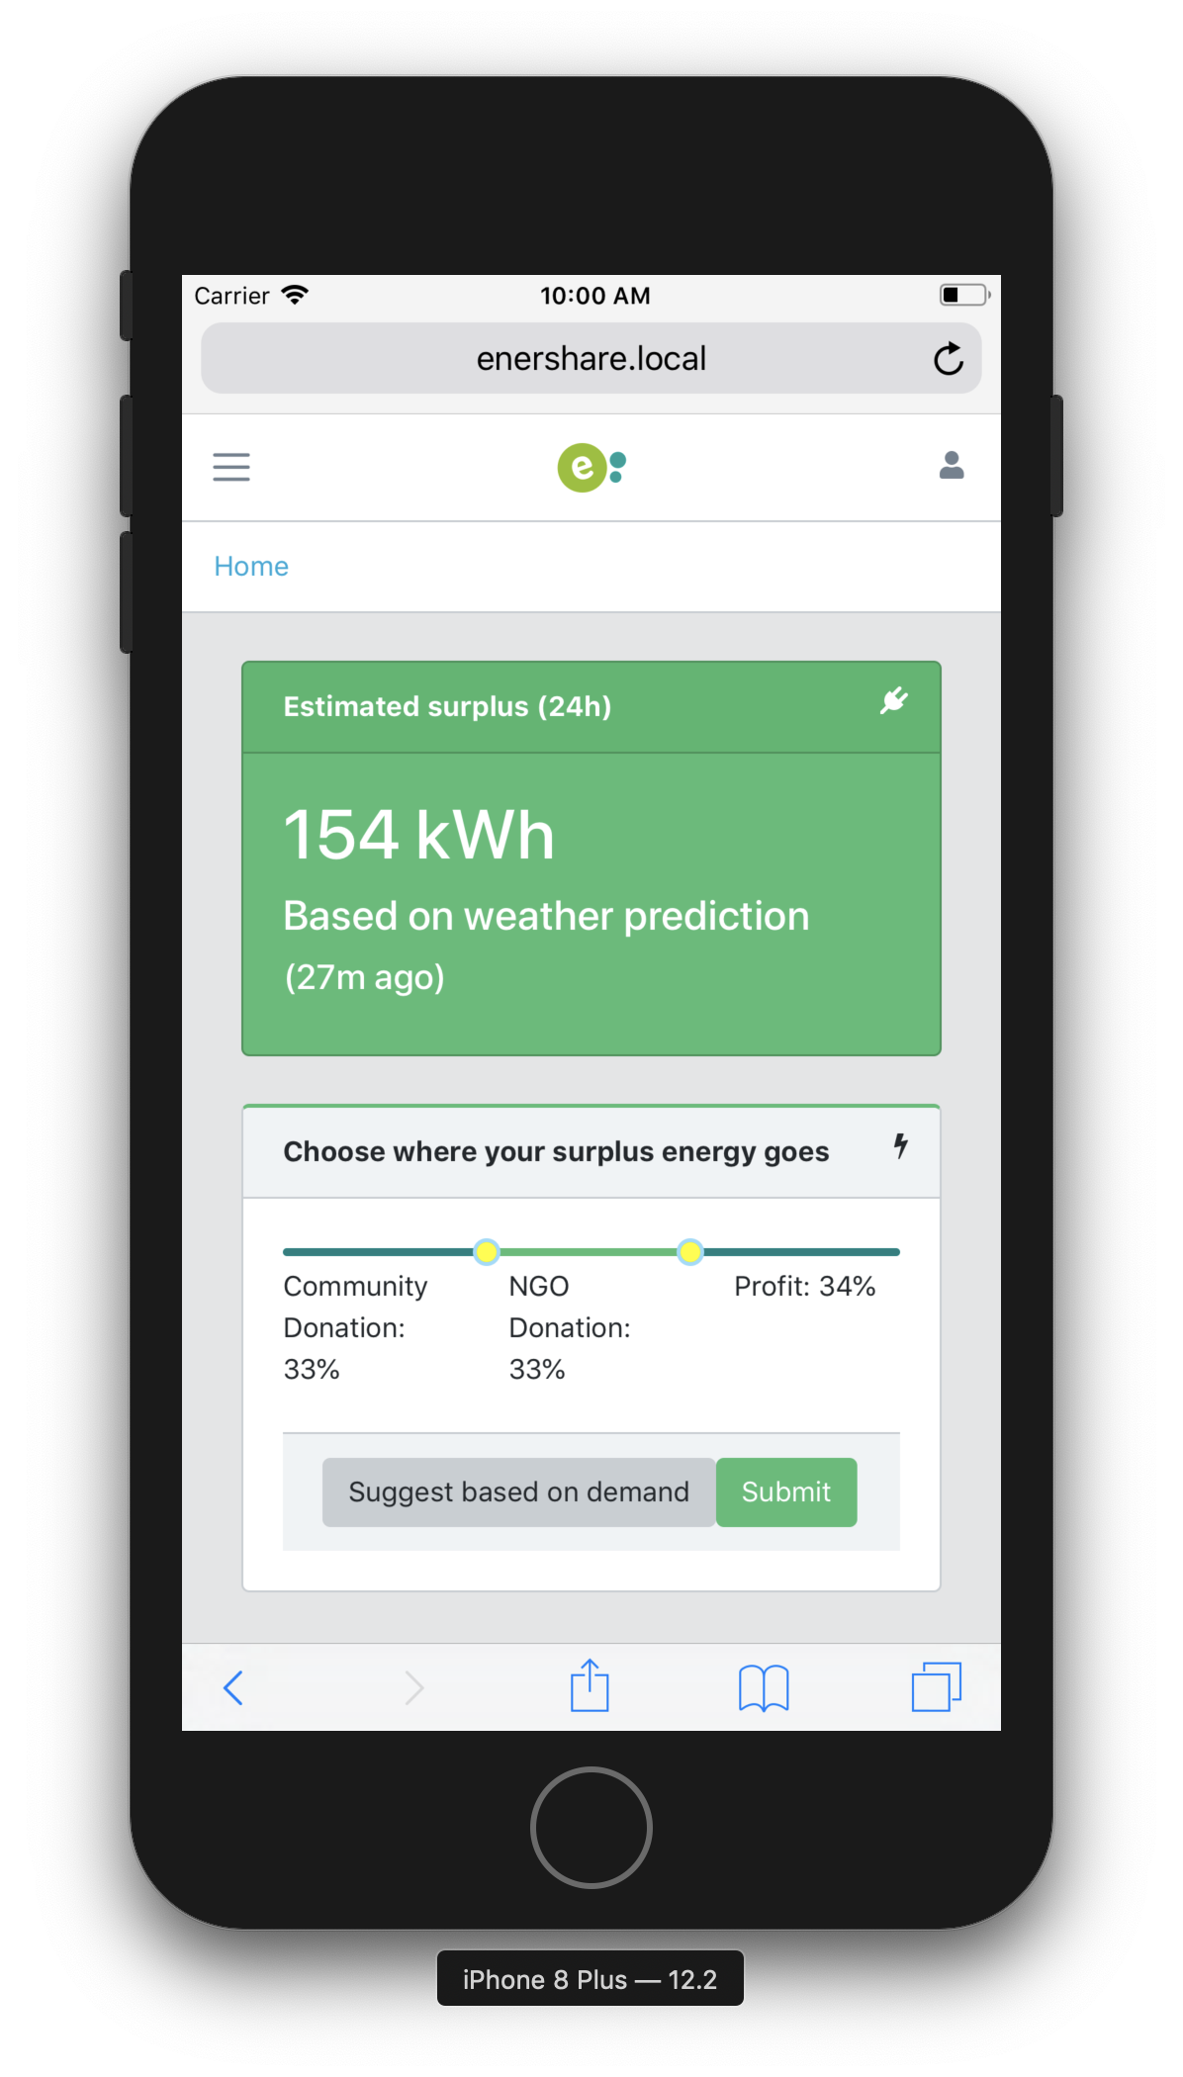
Prosumer
Set it and forget it
Change any time

Slide 12
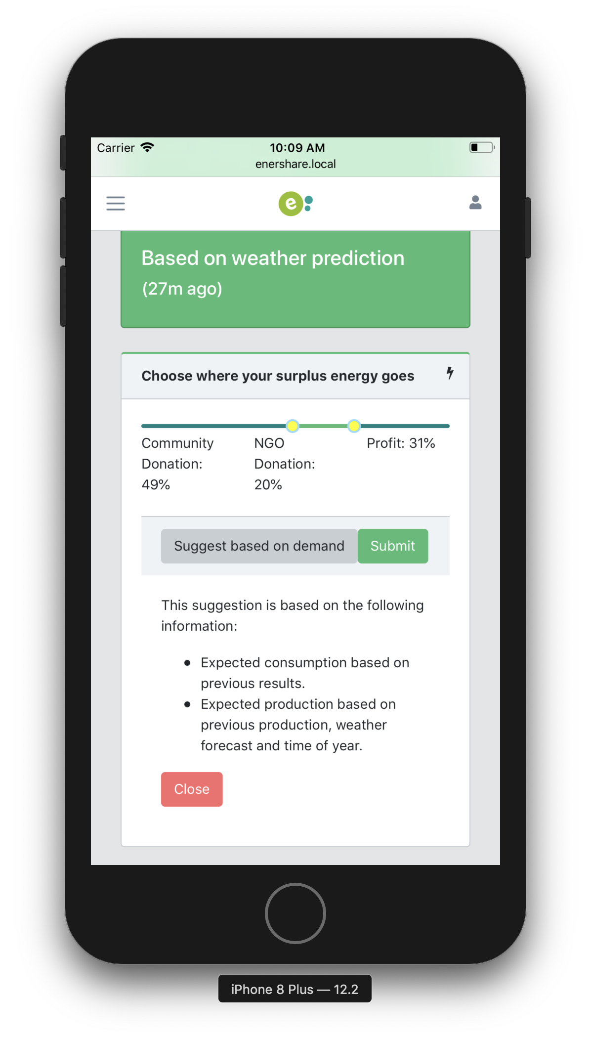
Prosumer
Suggestions to meet demand

Slide 13
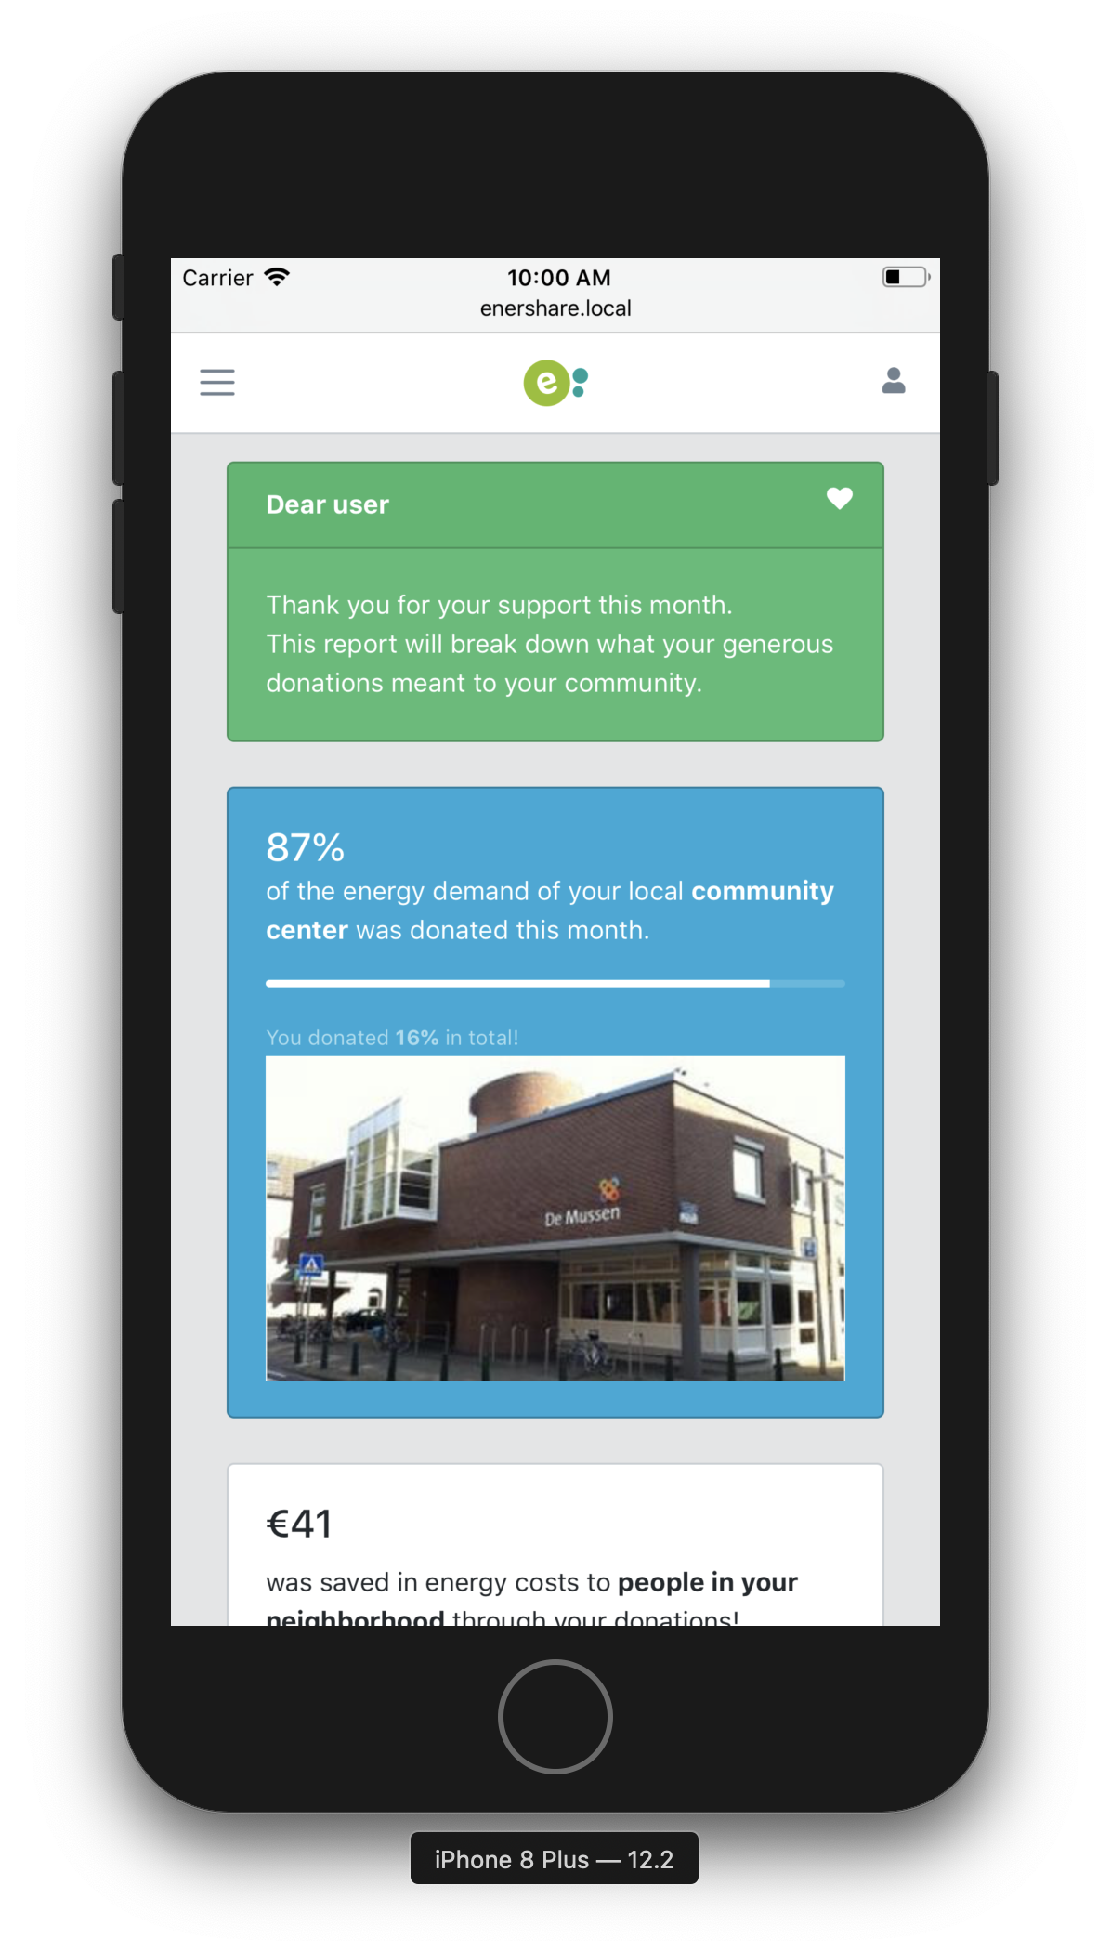
Prosumer
See your impact

Slide 14
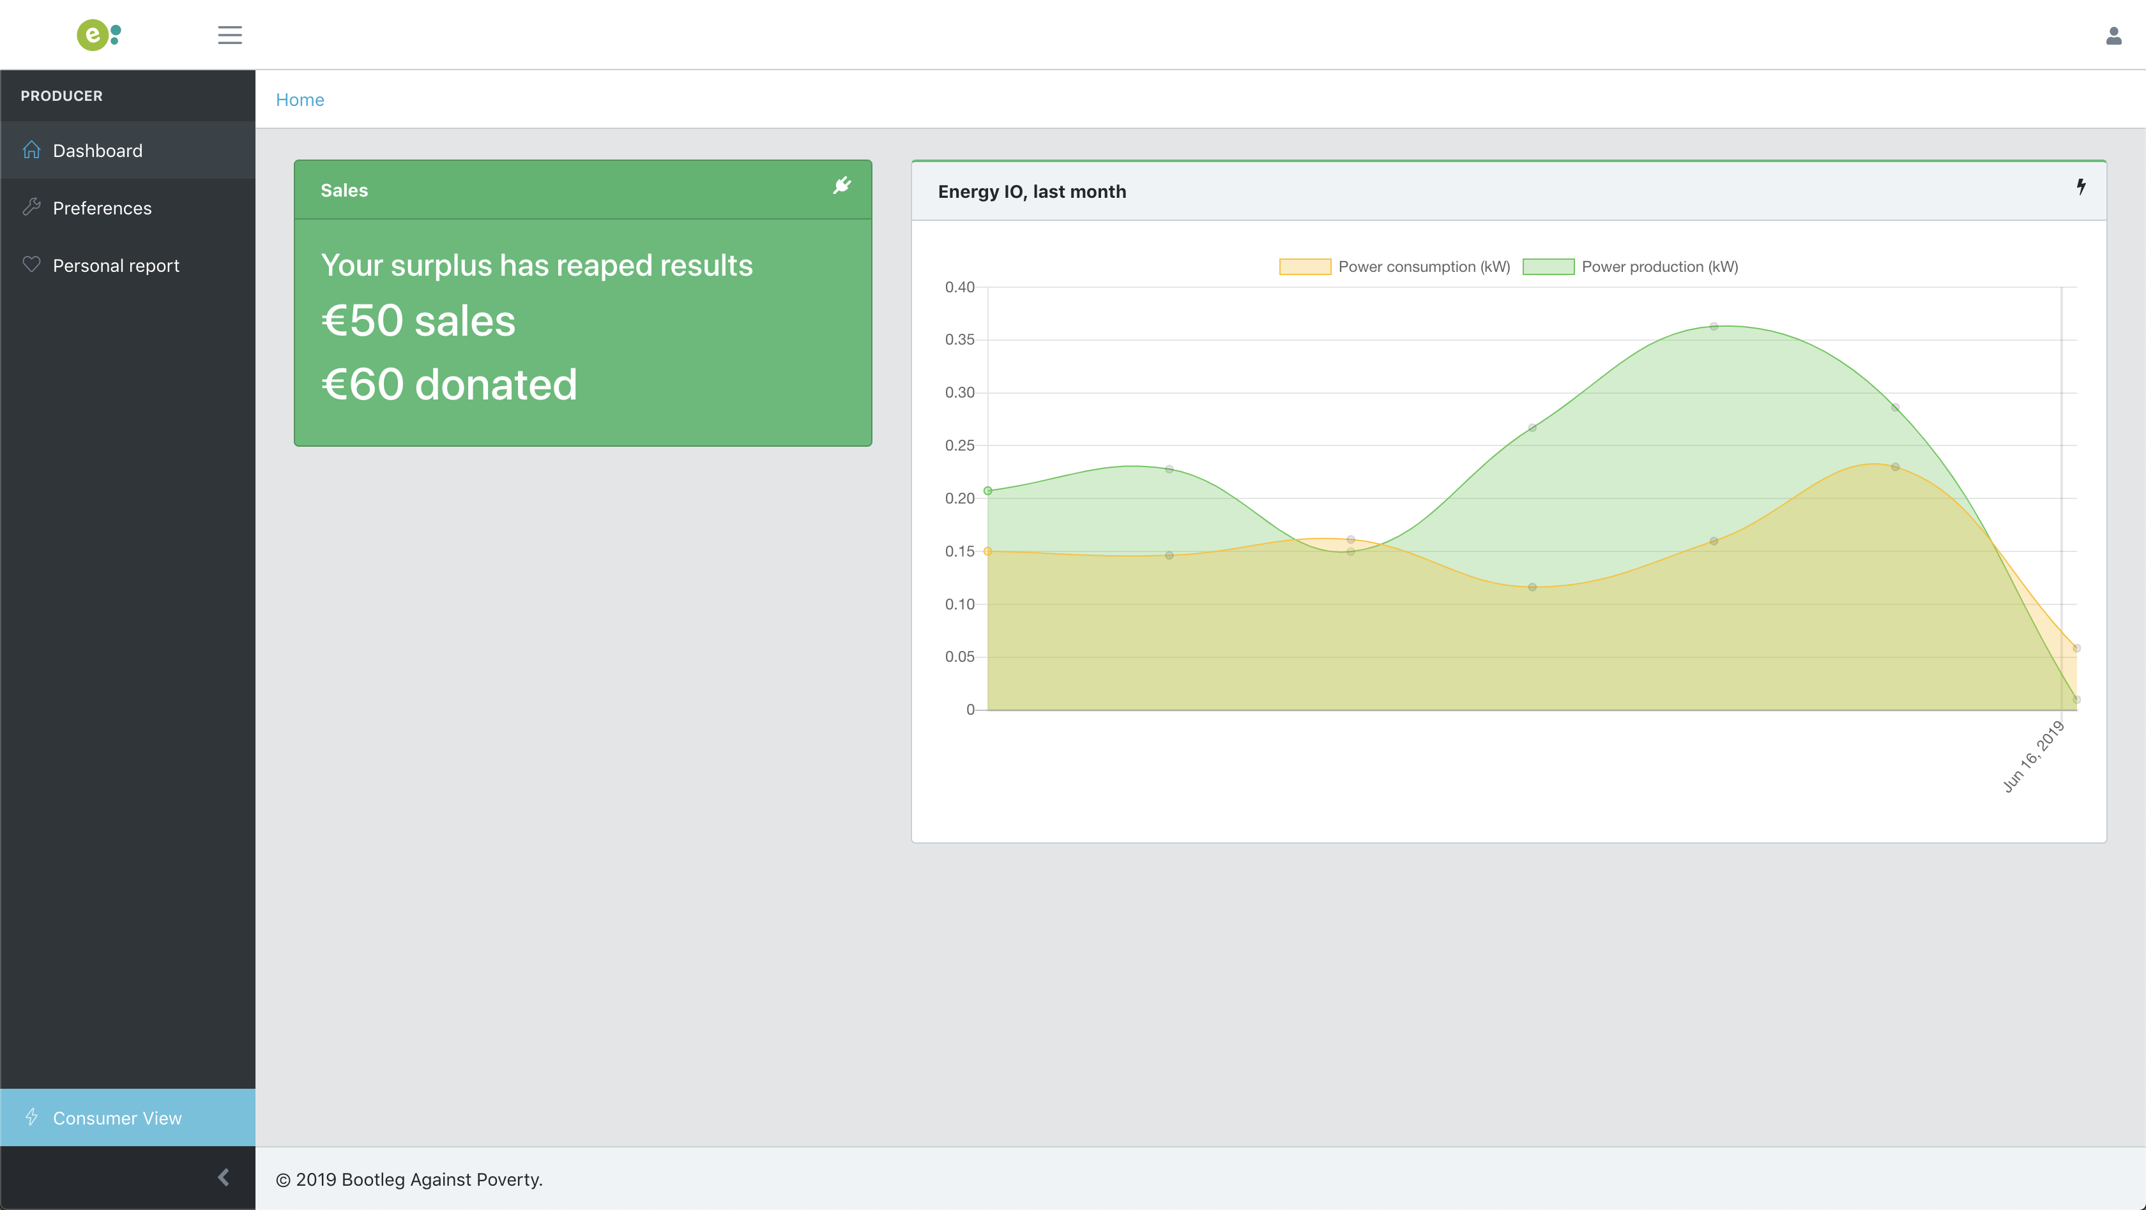

Slide 15
Easy to understand
Trustworthy predictions
Guidance
Consumer

Slide 16
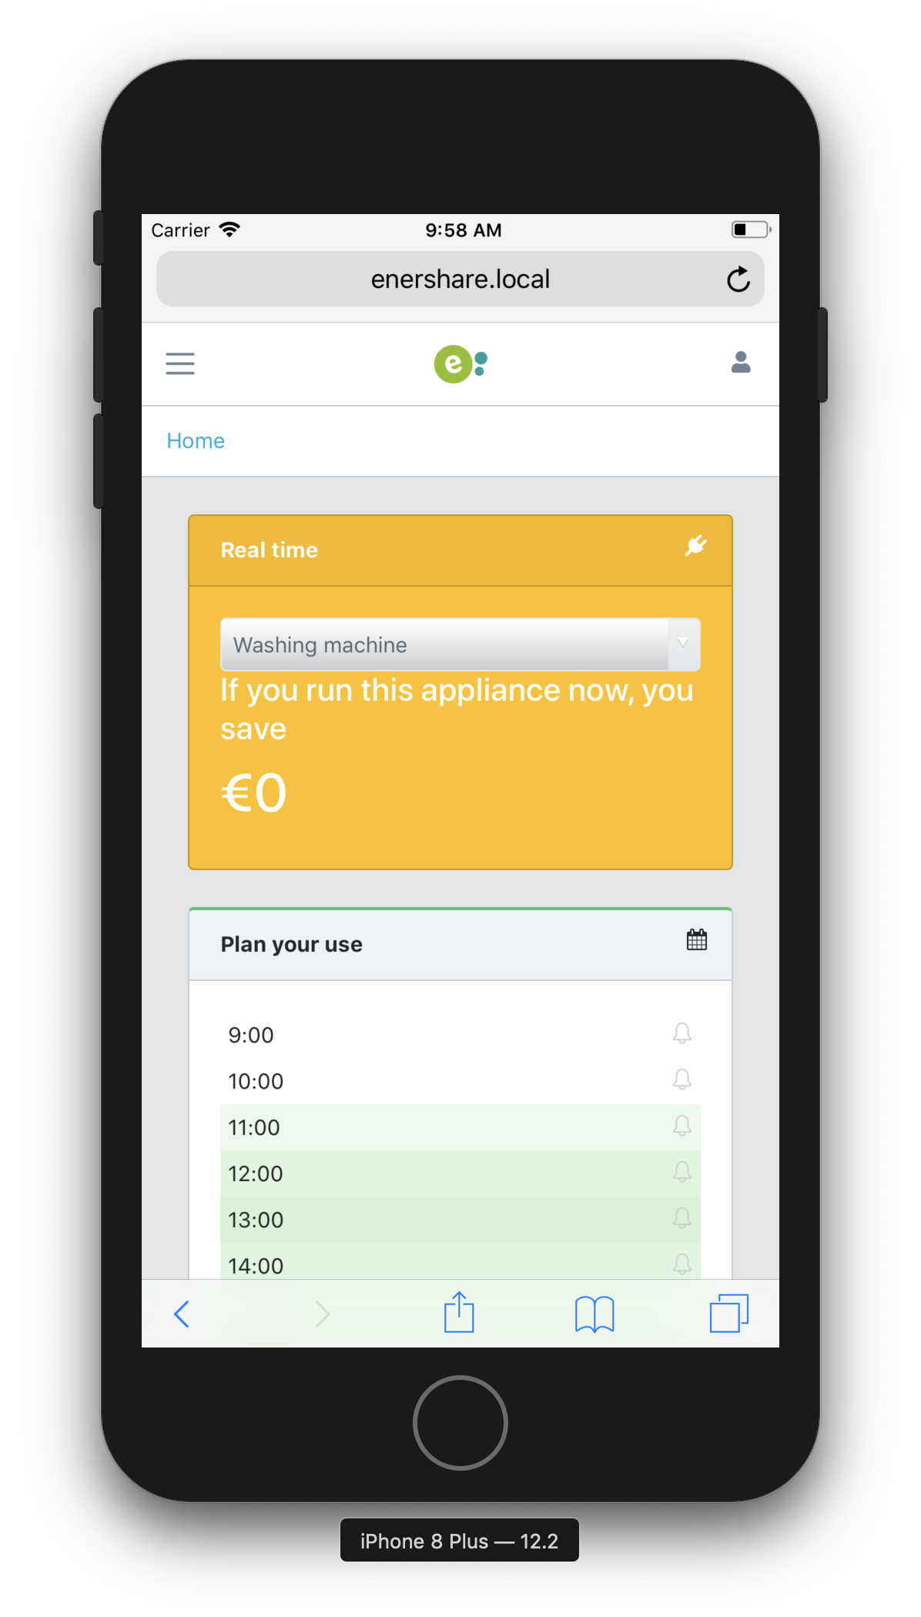
Consumer
Realtime
Predictions for planning

Slide 17
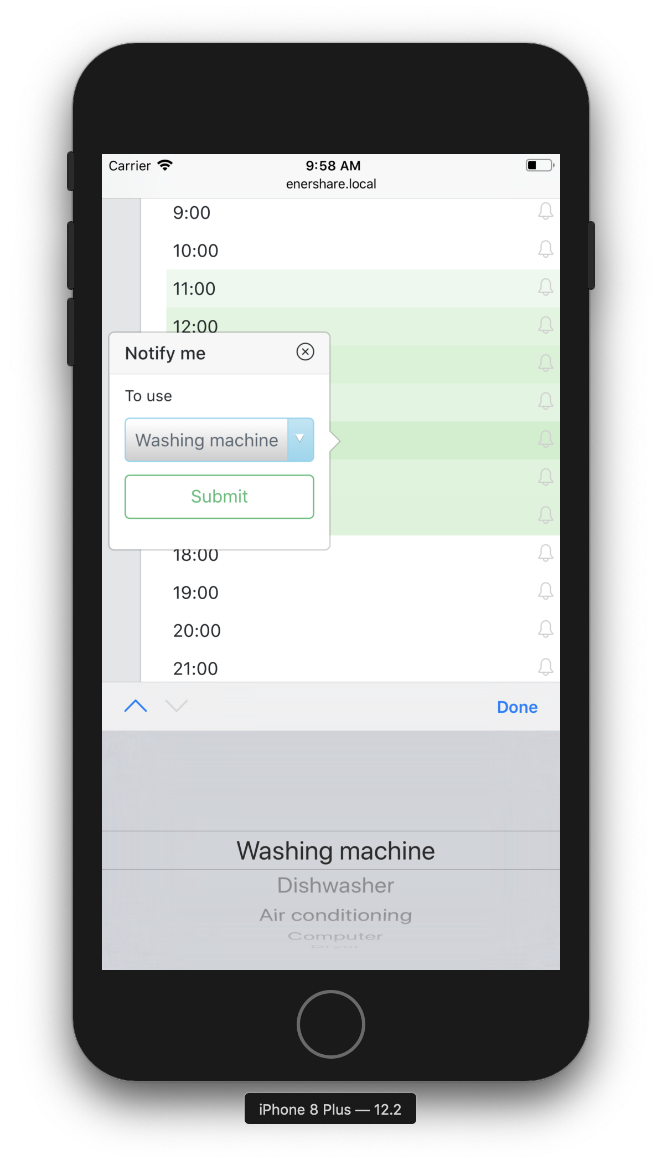
Consumer
Plan notifications
Can change
Data loop

Slide 18
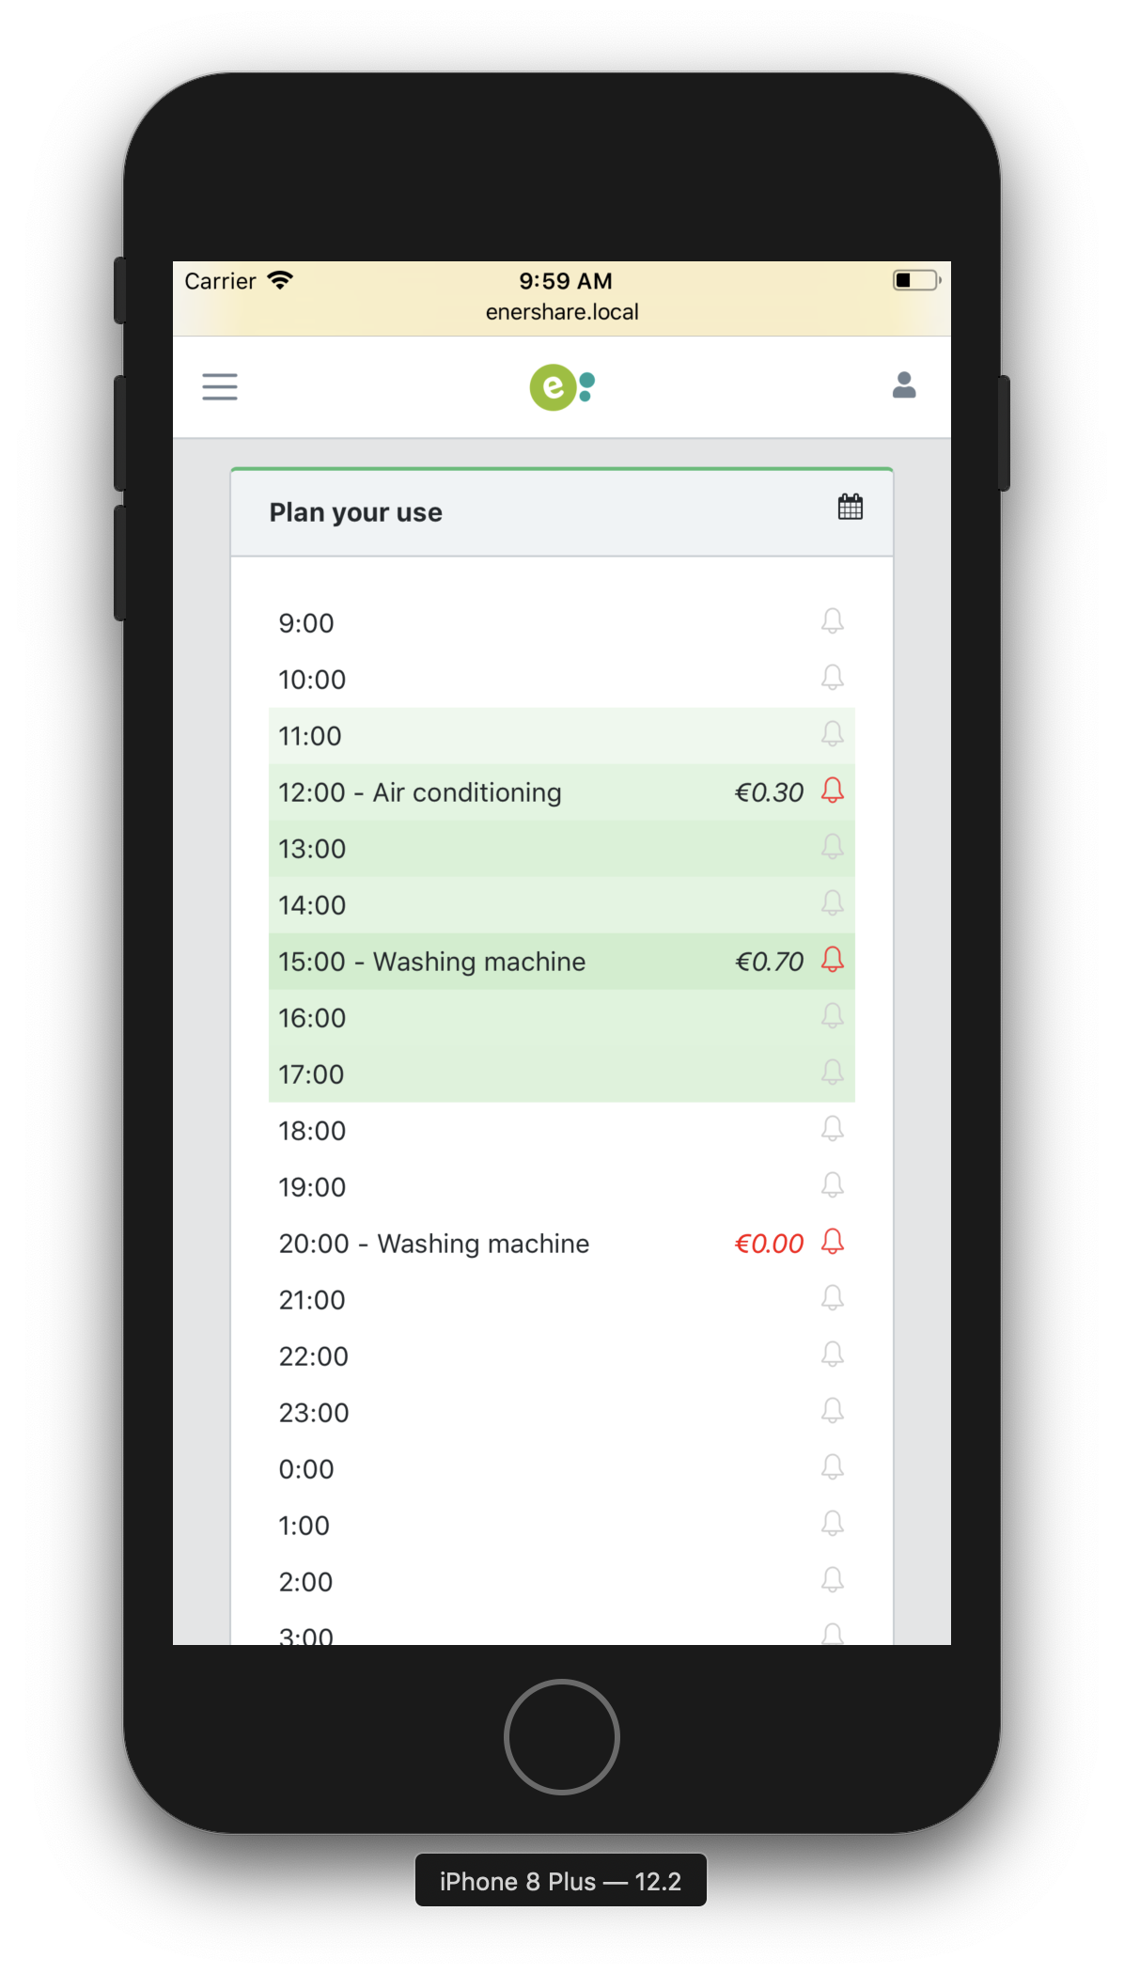
Consumer
Understandable
See what you save
Based user data

Slide 19
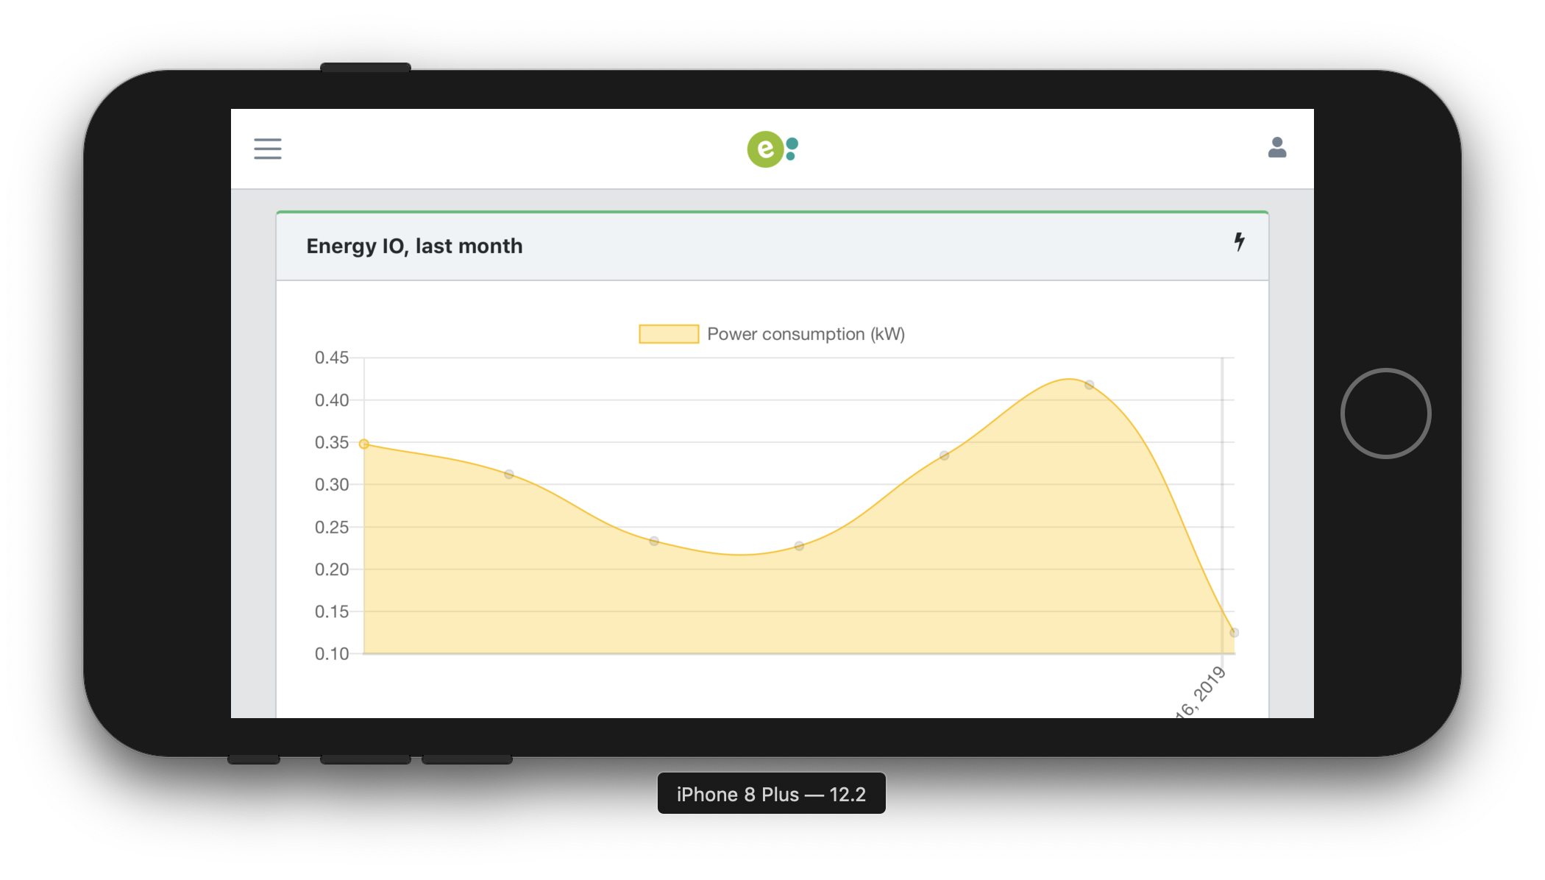
Consumer

Slide 20


6% error
Weather
Historical
Production
Prediction

Slide 21
Timely use
No waste
Powergrid

Slide 22
Next steps
Virtual energy currency
Smart contracts
Statistics and insights
Push notifications

Slide 23
Enershare
Fair sharing of energy
Maintain autonomy
Improve their behaviour
Made for humans

Slide 24
Sharing energy
Shouldn’t cost energy

Slide 25
Try it now

Slide 26
Enershare

